Slide 1
COM 220: Software Engineering 1
Lecture 01-02

Slide 2
Introduction
What is Software?
Software products are developed for consumption by system users.
    The association of the documentation, such as requirements, the design and manual including the computer programs make up a software.
Software can be;
      Customized: that is designed for a specific customer and purpose
      Generic: designed for use by a wide range of customers, e.g Java, excel, Adobe software
  Software can be
      Reused
      Reconfigured if generic
      Developed – that is a new software can be developed.

Slide 3
What is software Engineering?
Software engineering is a discipline with the following properties
  Should have a systematic approach
  Should have a defined problem
  Use tools that are allowed/appropriate
  Consider engineering constraints
  Look at the available properties
    Therefore it refers to a systematic approach of solving defined problems using CASE tools to serve a given purpose.

Slide 4
System Engineering and Software Engineering
System engineering looks at the computer-based system developments.
These includes
    Software
    Hardware
    Process engineering
Software engineering is just a component or part of these processes
    That develops the software infrastructure
    Databases and system applications including their controls

Slide 5
Software Development Phases
Software engineering phase/process is a structure used in the development of software products
    There are many models for these processes, with each having different approach to tasks and activities that take place during the process.
    Sometimes these phases are called software development life cycle.
Software development implements process methodologies

Slide 6
Software Development Phases – Cont’n
The software development are composed of many activities and these include;
  Requirements analysis
  Specification
  Software architecture/Design
  Implementation
  Testing
  Documentation
  Training and support
  Maintenance

Slide 7
Requirements Analysis
This is the first step in software development
  It helps you extract the desired software product
  Its where the customer’s knowledge of what the software will do is not required
    This stage requires skill and knowledge in software engineering
  Its where the developers recognize ambiguous, incomplete and contradictory requirements
  This stage should be reviewed to before the development starts

Slide 8
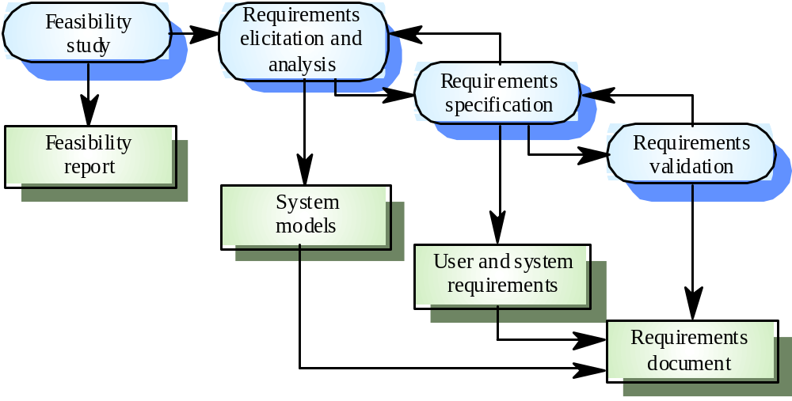
Requirements engineering process

Slide 9
Specification
Here you describe the software to be developed.
  It can be written using mathematical skills
Sometimes this stage helps in fine-tuning the already written software
  Specifics are normally good for external interfaces that remain stable most of the time

Slide 10
Software Design
This is the abstract representation of the system – design
Concerned with the software system meeting the requirements of the products
    Is it in line with the first stage of development?
Software architecture is also concerned about the future requirements of the system.
    Can we address the requirements of the system in future?

Slide 11
Design methods
Systematic approaches to developing a software design
  The design is usually documented as a set of graphical models
Possible models
    Entity-relation-attribute model
    Structural model
    Data-flow model
    Object models

Slide 12
The software design process
R
equir
ements
specifica
tion
Design activities
chitectur
Da
ta
Ar
al
Abstr
act
Inter
face
Component
Algorithm
structur
design
specifica
e
tion
design
design
design
design
S
Da
ta
ystem
Softw
ar
e
Inter
face
Component
structur
Algorithm
ar
e
chitectur
e
specifica
tion
specifica
tion
specifica
tion
specifica
specifica
tion
tion
Design Products

Slide 13
Implementation Phase
Reducing a design to code may be the most obvious part of the software engineering
    The design becomes executable program
    However it is not necessarily the largest portion.
Implementation or coding is not generic, it’s a personal task – for programmers
  Programmers are involved in testing the code, this helps in removing bugs
    Bugs cause runtime errors.
    The process of removing bugs from a program is called debugging.

Slide 14
Programming and debugging
Is a process that deals with translating a design into a program and removing errors from that program.
Programming is a personal activity - there is no generic programming process.
These two process co-exist, dependent on each other.
Programmers carry out some program testing to discover faults in the program and remove these faults in the debugging process.

Slide 15

The debugging process

Slide 16
Testing
This involves testing the parts of the software developed
Integration of two codes by different developers
  This stage is important, it makes the software engineers/developers appreciate the product designed

Slide 17
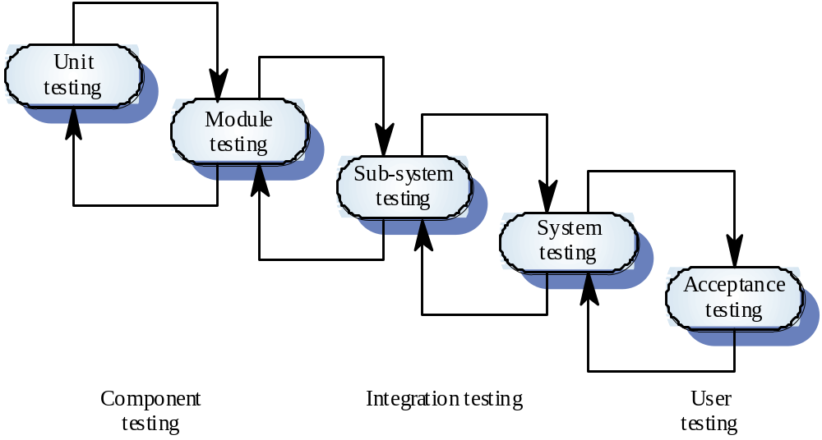
The testing process

Slide 18
Testing stages
Component or unit testing
  Here each component is tested independently;
  Components may be functions or objects or coherent groupings of these entities.
Integration testing
  Testing of the system as a whole. Testing of emergent properties is particularly important.
Acceptance testing – [User testing]
  Testing with customer data to check that the system meets the customer’s needs.

Slide 19
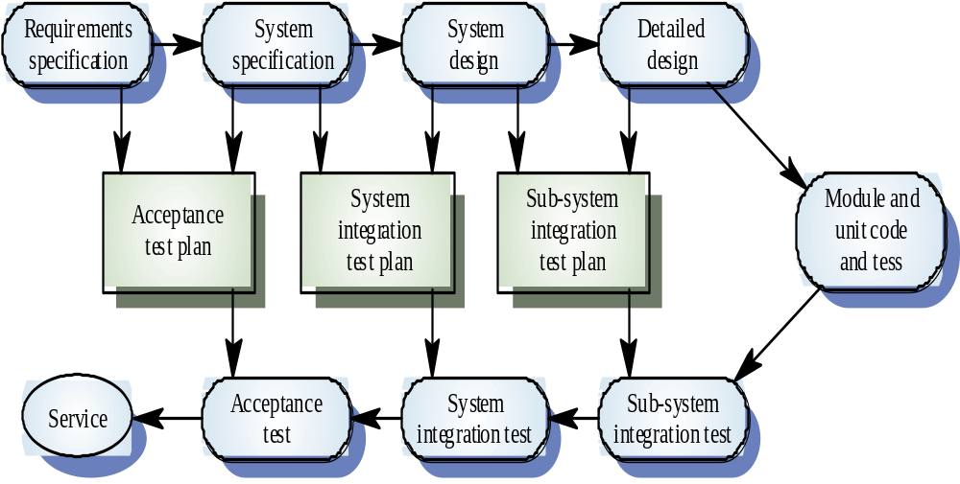
Testing phases

Slide 20
Software evolution
Software can change.
  It may be due to requirements change
  Business priorities and circumstances can also change
  These changes makes the software to evolve, to suite the current business needs

Slide 21
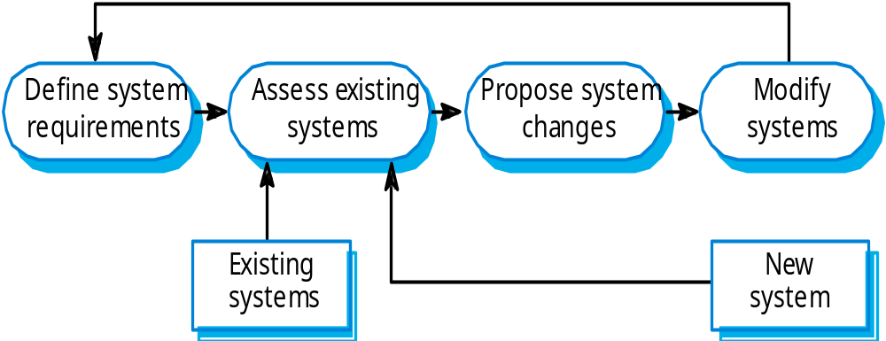
System evolution

Slide 22
Documentation
Helps in future maintenance of the system software
  The internal design is documented for enhancement

Slide 23
Training and Support
Overlooked if implementation is successful
  Developers don’t care if the software is used or not!
  Its always better to train the end users how the software works and how it will be useful to them
  It helps the organization adopt to the new software with ease.
    Can help in future to know what problem may need fixing as a result of question you encounter during training
    Complaints by users may make adjust for the better.

Slide 24
Maintenance
The longest phase in software development
Deals with changes(maintenance) of the requirements which is the first phase of the development process.
    The newly laid out requirements become very difficult to fit into the previous design.
      E.g. fixing bugs may be a problem if codes is large
Most maintenance is considered new work because the system may be required to do something out side the previous scope.

